Slide 1
Rutgers University
School of Engineering
Fall 2022
332:231 – Digital Logic Design
Sophocles J. Orfanidis
ECE Department orfanidi@rutgers.edu
Unit 5 – arithmetic systems, comparators, adders, multipliers

Slide 2
Course Topics
1. Introduction to DLD, Verilog HDL, MATLAB/Simulink
2. Number systems
3. Analysis and synthesis of combinational circuits
4. Decoders/encoders, multiplexers/demultiplexers
5. Arithmetic systems, comparators, adders, multipliers
6. Sequential circuits, latches, flip-flops
7. Registers, shift registers, counters, LFSRs
8. Finite state machines, analysis and synthesis
Text: J. F. Wakerly, Digital Design Principles and Practices, 5/e, Pearson, 2018
additional references on Canvas Files > References

Slide 3
Components for arithmetic operations (Wakerly, Ch. 7 & 8).
Topics discussed are:
Comparators for unsigned integers and for and two’s complement signed integers
half-adders
full-adders
ripple adders/subtractors for two’s complement integers
carry-lookahead adders
overflow in addition/subtraction
multiplier combinational circuits

Slide 4
Unit-5 Contents:
1. Comparators for unsigned and signed 2’s complement integers
2. Addition and subtraction
3. Half-adders
4. Full-adders
5. Full-adders – ripple adders
6. Full-adders – carry-look-ahead adders
7. Full-adders/subtractors for 2’s complement integers
8. Overflow in 2’s complement addition/subtraction
9. Multiplier combinational circuits

Slide 5
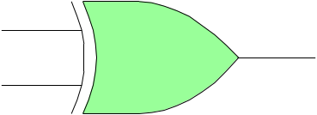
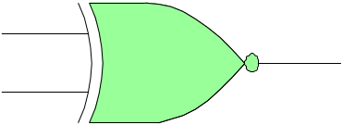
A comparator compares two binary words and determines if they are equal, or, if one is greater or less than the other. Depending on the implementation, the binary words may be unsigned or signed 2’s complement integers.
Comparators
XOR
a b D
0 0 0
0 1 1
1 0 1
1 1 0
XOR
a
XOR output D
detects difference
D = 1, if a ≠ b
D = a bʹ + aʹ b
b
XNOR
a b E
0 0 1
0 1 0
1 0 0
1 1 1
XNOR
a
XNOR output E
detects equality
E = 1, if a = b
E = a b + aʹ bʹ
E = Dʹ
b

Slide 6
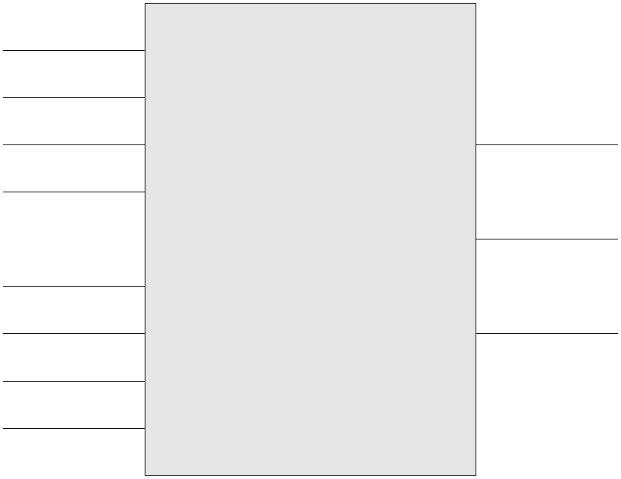
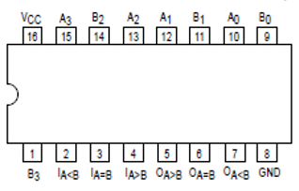
Design a comparator for 4-bit unsigned integers, and then modify it for 2’s complement integers
Comparators
a₃
a₂
a₁
a = b
E
a = (a₃ a₂ a₁ a₀)
b = (b₃ b₂ b₁ b₀)
a₀
4-bit unsigned
or signed
comparator
a < b
Motorola
SN54 / 74LS85
L
b₃
b₂
a > b
G
b₁
b₀
see also, https://en.wikipedia.org/wiki/Digital_comparator

Slide 7
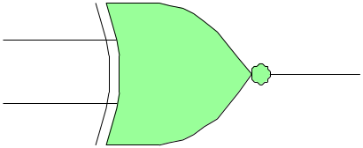
Design a comparator for 4-bit unsigned integers, and then modify it for 2’s complement integers
Comparators
we may use four XNORs to detect equality of the individual bits,
a = (a₃ a₂ a₁ a₀)
b = (b₃ b₂ b₁ b₀)
a₃
b₃
e₃
a₂
b₂
e₂
equality of all four bits is indicated by the AND operation,
a₁
b₁
e₁
E_{a=b} = e₃ e₂ e₁ e₀
a₀
b₀
e₀
see also, https://en.wikipedia.org/wiki/Digital_comparator

Slide 8
a = (a₃ a₂ a₁ a₀)
b = (b₃ b₂ b₁ b₀)
inequality (for unsigned, non-negative, integers) can be tested with the help of the individual XNOR outputs
Comparators
a > b is true if any of the following is true,
a₃ = 1, b₃ = 0
a₃ = b₃, and, a₂ = 1, b₂ = 0
a₃ = b₃, a₂ = b₂, and, a₁ = 1, b₁ = 0
a₃ = b₃, a₂ = b₂, a₁ = b₁, and, a₀ = 1, b₀ = 0
or, phrased in terms of the XNOR outputs,
a₃ = 1, b₃ = 0
e₃ = 1, and, a₂ = 1, b₂ = 0
e₃ = 1, e₂ = 1, and, a₁ = 1, b₁ = 0
e₃ = 1, e₂ = 1, e₁ =1, and, a₀ = 1, b₀ = 0
these can be combined into an overall expression,
a₃
b₃
e₃
a₂
b₂
e₂
a₁
b₁
e₁
a₀
b₀
e₀
G_{a>b} = a₃ b₃ʹ + e₃ a₂ b₂ʹ + e₃ e₂ a₁ b₁ʹ + e₃ e₂ e₁ a₀ b₀ʹ

Slide 9
a = (a₃ a₂ a₁ a₀)
b = (b₃ b₂ b₁ b₀)
inequality (for unsigned, non-negative, integers) can be tested with the help of the individual XNOR outputs
Comparators
a₃
b₃
a > b is true if
a₃ = 1, b₃ = 0
worst case:
a = (1 0 0 0)
b = (0 1 1 1)
a = 2³
b = 2² + 2¹ + 2⁰ = (2³ – 1) / (2 – 1) = 2³ – 1
thus, a > b
and, G_{a>b} = 1 ∙ 1 + 0 + 0 + 0 = 1
e₃
a₂
b₂
e₂
a₁
b₁
e₁
a₀
b₀
e₀
G_{a>b} = a₃ b₃ʹ + e₃ a₂ b₂ʹ + e₃ e₂ a₁ b₁ʹ + e₃ e₂ e₁ a₀ b₀ʹ

Slide 10
x bits
----------------
0 0 0 0 0
1 0 0 0 1
2 0 0 1 0
3 0 0 1 1
4 0 1 0 0
5 0 1 0 1
6 0 1 1 0
7 0 1 1 1
8 1 0 0 0
9 1 0 0 1
10 1 0 1 0
11 1 0 1 1
12 1 1 0 0
13 1 1 0 1
14 1 1 1 0
15 1 1 1 1
a = (a₃ a₂ a₁ a₀)
b = (b₃ b₂ b₁ b₀)
Comparators
a > b is true any of the following is true,
a₃ = 1, b₃ = 0
a₃ = b₃, and, a₂ = 1, b₂ = 0
a₃ = b₃, a₂ = b₂, and, a₁ = 1, b₁ = 0
a₃ = b₃, a₂ = b₂, a₁ = b₁, and, a₀ = 1, b₀ = 0
or, phrased in terms of the XNOR outputs,
a₃ = 1, b₃ = 0
e₃ = 1, and, a₂ = 1, b₂ = 0
e₃ = 1, e₂ = 1, and, a₁ = 1, b₁ = 0
e₃ = 1, e₂ = 1, e₁ =1, and, a₀ = 1, b₀ = 0
these can be combined into an overall expression,
G_{a>b} = a₃ b₃ʹ + e₃ a₂ b₂ʹ + e₃ e₂ a₁ b₁ʹ + e₃ e₂ e₁ a₀ b₀ʹ

Slide 11
x bits
----------------
0 0 0 0 0
1 0 0 0 1
2 0 0 1 0
3 0 0 1 1
4 0 1 0 0
5 0 1 0 1
6 0 1 1 0
7 0 1 1 1
8 1 0 0 0
9 1 0 0 1
10 1 0 1 0
11 1 0 1 1
12 1 1 0 0
13 1 1 0 1
14 1 1 1 0
15 1 1 1 1
a = (a₃ a₂ a₁ a₀)
b = (b₃ b₂ b₁ b₀)
Comparators
a > b is true any of the following is true,
a₃ = 1, b₃ = 0
a₃ = b₃, and, a₂ = 1, b₂ = 0
a₃ = b₃, a₂ = b₂, and, a₁ = 1, b₁ = 0
a₃ = b₃, a₂ = b₂, a₁ = b₁, and, a₀ = 1, b₀ = 0
or, phrased in terms of the XNOR outputs,
a₃ = 1, b₃ = 0
e₃ = 1, and, a₂ = 1, b₂ = 0
e₃ = 1, e₂ = 1, and, a₁ = 1, b₁ = 0
e₃ = 1, e₂ = 1, e₁ =1, and, a₀ = 1, b₀ = 0
these can be combined into an overall expression,
G_{a>b} = a₃ b₃ʹ + e₃ a₂ b₂ʹ + e₃ e₂ a₁ b₁ʹ + e₃ e₂ e₁ a₀ b₀ʹ

Slide 12
x bits
----------------
0 0 0 0 0
1 0 0 0 1
2 0 0 1 0
3 0 0 1 1
4 0 1 0 0
5 0 1 0 1
6 0 1 1 0
7 0 1 1 1
8 1 0 0 0
9 1 0 0 1
10 1 0 1 0
11 1 0 1 1
12 1 1 0 0
13 1 1 0 1
14 1 1 1 0
15 1 1 1 1
a = (a₃ a₂ a₁ a₀)
b = (b₃ b₂ b₁ b₀)
Comparators
a > b is true any of the following is true,
a₃ = 1, b₃ = 0
a₃ = b₃, and, a₂ = 1, b₂ = 0
a₃ = b₃, a₂ = b₂, and, a₁ = 1, b₁ = 0
a₃ = b₃, a₂ = b₂, a₁ = b₁, and, a₀ = 1, b₀ = 0
or, phrased in terms of the XNOR outputs,
a₃ = 1, b₃ = 0
e₃ = 1, and, a₂ = 1, b₂ = 0
e₃ = 1, e₂ = 1, and, a₁ = 1, b₁ = 0
e₃ = 1, e₂ = 1, e₁ =1, and, a₀ = 1, b₀ = 0
these can be combined into an overall expression,
G_{a>b} = a₃ b₃ʹ + e₃ a₂ b₂ʹ + e₃ e₂ a₁ b₁ʹ + e₃ e₂ e₁ a₀ b₀ʹ

Slide 13
a < b can be constructed in terms of the
a = b and a > b expressions,
Comparators
L_{a<b} = E_{a=b}ʹ G_{a>b}ʹ = (E_{a=b} + G_{a>b})ʹ = NOR operation
Summary – 4-bit unsigned comparator
e₃ = (a₃ ⊕ b₃)ʹ
e₂ = (a₂ ⊕ b₂)ʹ
e₁ = (a₁ ⊕ b₁)ʹ
e₀ = (a₀ ⊕ b₀)ʹ
E_{a=b} = e₃ e₂ e₁ e₀
G_{a>b} = a₃ b₃ʹ + e₃ a₂ b₂ʹ + e₃ e₂ a₁ b₁ʹ + e₃ e₂ e₁ a₀ b₀ʹ
L_{a<b} = (E_{a=b} + G_{a>b})ʹ
math notation:
XOR(a, b) = a ⊕ b
XNOR(a, b) = (a ⊕ b)ʹ
using associativity
E+G+L = E+G+EʹGʹ = E+G+Eʹ = 1 + G = 1
and also
e₃a₃ b₃ʹ = 0
e₂a₂ b₂ʹ = 0
e₁a₁ b₁ʹ = 0
e₀a₀ b₀ʹ = 0 E G = 0
overall realization shown on next page
E + G + L = 1, and, E G = E L = G L = 0

Slide 14
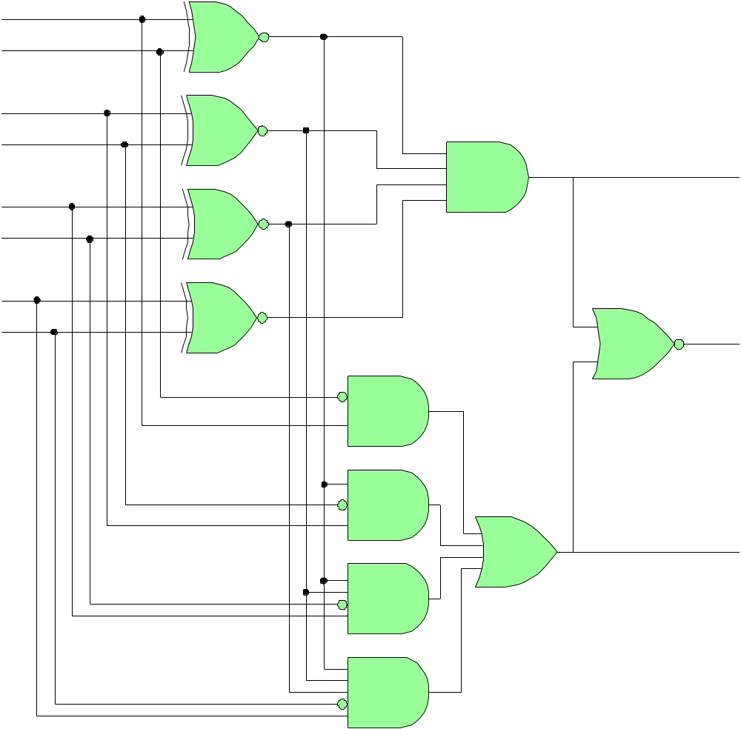
a₃
b₃
e₃
e₂
e₁
e₀
Comparators
a₂
b₂
E_{a=b}
a₁
b₁
a₀
b₀
L_{a<b}
G_{a>b} = a₃ b₃ʹ
+ e₃ a₂ b₂ʹ
+ e₃ e₂ a₁ b₁ʹ
+ e₃ e₂ e₁ a₀ b₀ʹ
G_{a>b}
4-bit comparator
for unsigned integers

Slide 15
for the 2’s complement case,
if a₃ = b₃, then use the unsigned version
if a₃ ≠ b₃, then must invert both L_{a<b} and G_{a>b}
and may introduce a selector input u for choosing
the unsigned (u=1) or the signed case (u=0)
Comparators
c = u + e₃
L_{a<b} = (c ⊕ L)ʹ
G_{a>b} = (c ⊕ G)ʹ
u e₃ c invert L,G
0 0 0 invert
0 1 1 do not invert
1 0 1 do not invert
1 1 1 do not invert
a₃
a₂
a₁
a = b
E
a₀
4-bit unsigned
comparator
a < b
L
use XOR properties
0 ⊕ L = L
0 ⊕ G = G
1 ⊕ L = Lʹ
1 ⊕ G = Gʹ
b₃
b₂
a > b
G
b₁
b₀

Slide 16

x mod(x,2⁴) bits
0 0 0 0 0 0
1 1 0 0 0 1
2 2 0 0 1 0
3 3 0 0 1 1
4 4 0 1 0 0
5 5 0 1 0 1
6 6 0 1 1 0
7 7 0 1 1 1
8 -8 1 0 0 0
9 -7 1 0 0 1
10 -6 1 0 1 0
11 -5 1 0 1 1
12 -4 1 1 0 0
13 -3 1 1 0 1
14 -2 1 1 1 0
15 -1 1 1 1 1
Comparators
in the 2’s complement representation,
the mod-operation maps all negative integers to their unsigned versions with the same bit pattern, thus,
if, a₃ = b₃, (a, b are both positive or both
negative), then, the sense of the
inequality is preserved (L_{a<b} = L), e.g.,
4 > 3
−4 < −3, with unsigned version, 12 < 13
if, a₃ ≠ b₃, then the inequality direction
is reversed (L_{a<b} = Lʹ), e.g.,
−4 < 3, with unsigned version, 12 > 3
5 > −3, with unsigned version, 5 < 13

Slide 17
x mod(x,2⁴) bits
7 7 0 1 1 1
6 6 0 1 1 0
5 5 0 1 0 1
4 4 0 1 0 0
3 3 0 0 1 1
2 2 0 0 1 0
1 1 0 0 0 1
0 0 0 0 0 0
-1 15 1 1 1 1
-2 14 1 1 1 0
-3 13 1 1 0 1
-4 12 1 1 0 0
-5 11 1 0 1 1
-6 10 1 0 1 0
-7 9 1 0 0 1
-8 8 1 0 0 0
Comparators
in the 2’s complement representation,
the mod-operation maps all negative integers to their unsigned versions with the same bit pattern, thus,
if, a₃ = b₃, (a, b are both positive or both
negative), then, the sense of the
inequality is preserved (L_{a<b} = L), e.g.,
4 > 3
−4 < −3, with unsigned version, 12 < 13
if, a₃ ≠ b₃, then the inequality direction
is reversed (L_{a<b} = Lʹ), e.g.,
−4 < 3, with unsigned version, 12 > 3
5 > −3, with unsigned version, 5 < 13

Slide 18
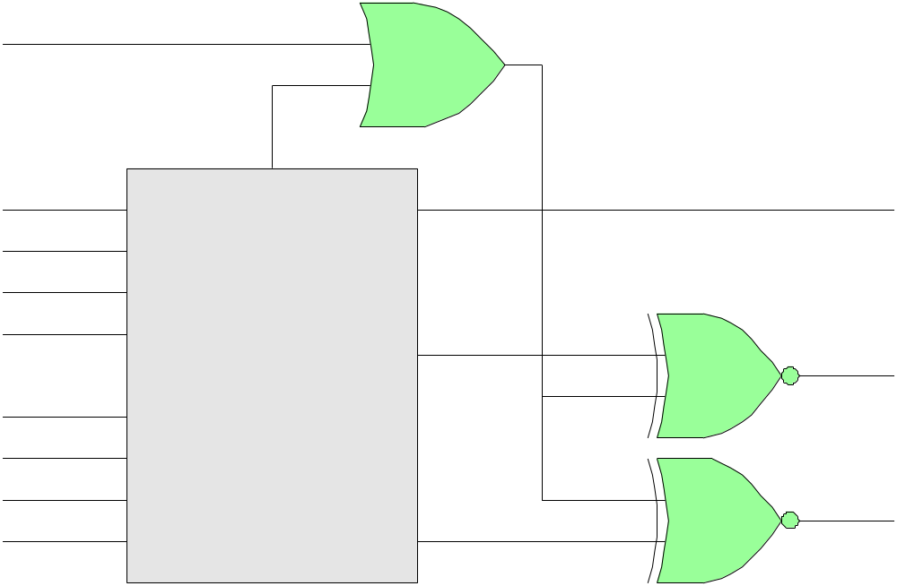
selector
4-bit two’s complement comparator
Comparators
u
e₃
c
a₃
E
E_{a=b}
a₂
a₁
a₀
L
4-bit unsigned
comparator
L_{a<b}
b₃
c
b₂
b₁
c
b₀
G
G_{a>b}
c = u + e₃
L_{a<b} = (c ⊕ L)ʹ
G_{a>b} = (c ⊕ G)ʹ
still valid: E + G + L = 1, E G = 0, E L = 0, G L = 0

Slide 19
% typical MATLAB code, given a=[a3,a2,a1,a0], b=[b3,b2,b1,b0]
a3 = a(1); a2 = a(2); a1 = a(3); a0 = a(4);
b3 = b(1); b2 = b(2); b1 = b(3); b0 = b(4);
e3 = ~xor(a3,b3);
e2 = ~xor(a2,b2);
e1 = ~xor(a1,b1);
e0 = ~xor(a0,b0);
c = u | e3;
E = e3 & e2 & e1 & e0;
G = (a3 & ~b3) | (e3 & a2 & ~b2) | …
(e3 & e2 & a1 & ~b1) | (e3 & e2 & e1 & a0 & ~b0);
L = ~(E | G);
G = ~xor(c,G);
L = ~xor(c,L);
% incorporated into the function, comp4.m, on Canvas Files
line continuation symbol

Slide 20
% comp4.m - 4-bit unsigned and 2's complement signed comparator
%
% Usage: [E,G,L] = comp4(a,b,u);
%
% a = 4-bit integer, a = [a3,a2,a1,a0]
%
% b = Lx4 matrix of bits, , each row representing an integer
%
% u = 1, 0, for unsigned or signed case, default u=1
%
% E,G,L = Lx1 vectors representing equal, greater than, less than
%
% Example: A = -3;
% a = a2d(A,4); % a = [1 1 0 1]
%
% [b3,b2,b1,b0] = a2d(-8:7, 4); % 15x4 matrix
%
% [E, G, L] = comp4(a,[b3,b2,b1,b0],0); % comparisons
%
% plotted below (p.28)

Slide 21
function [E,G,L] = comp4(a,b,u)
a3 = a(1); a2 = a(2); a1 = a(3); a0 = a(4);
for i=1:size(b,1)
b3 = b(i,1); b2 = b(i,2); b1 = b(i,3); b0 = b(i,4);
e3 = ~xor(a3,b3); e2 = ~xor(a2,b2);
e1 = ~xor(a1,b1); e0 = ~xor(a0,b0);
c = u | e3;
E(i) = e3 & e2 & e1 & e0;
G(i) = (a3 & ~b3) | (e3 & a2 & ~b2) | …
(e3 & e2 & a1 & ~b1) | (e3 & e2 & e1 & a0 & ~b0);
L(i) = ~(E(i) | G(i));
G(i) = ~xor(c,G(i));
L(i) = ~xor(c,L(i));
end
E = E(:); G = G(:); L = L(:);
line continuation symbol

Slide 22
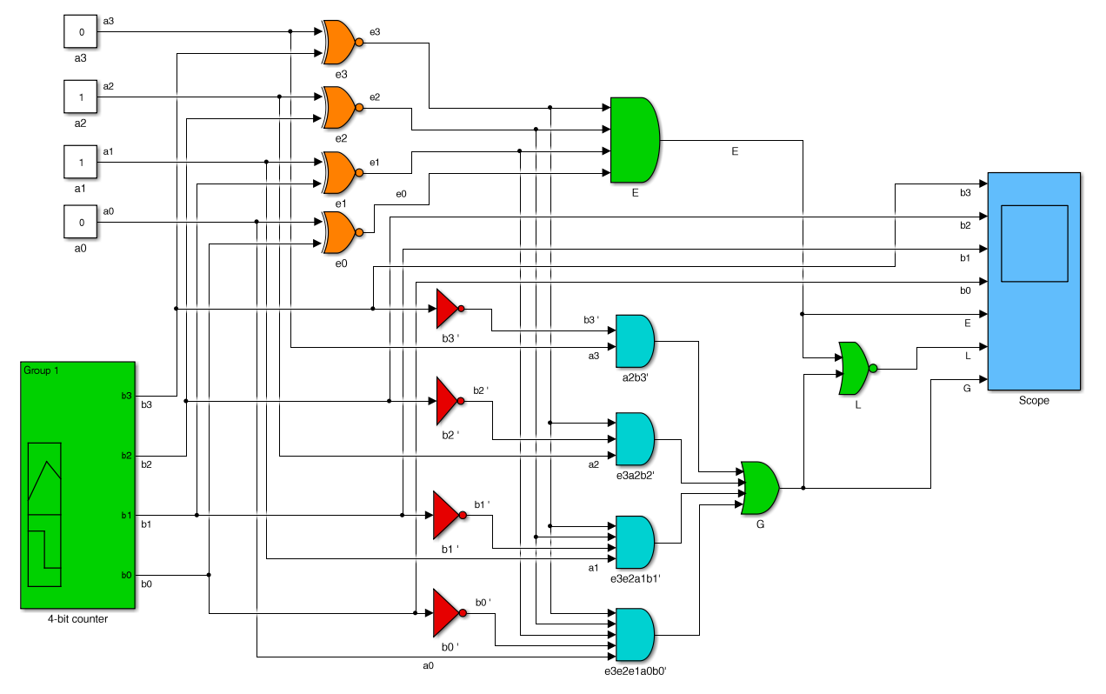
file: comp4s.slx on Canvas
Simulink implementation
successively compares the fixed number
a = 6 = (0 1 1 0)
with a binary counter sequence, b

Slide 23
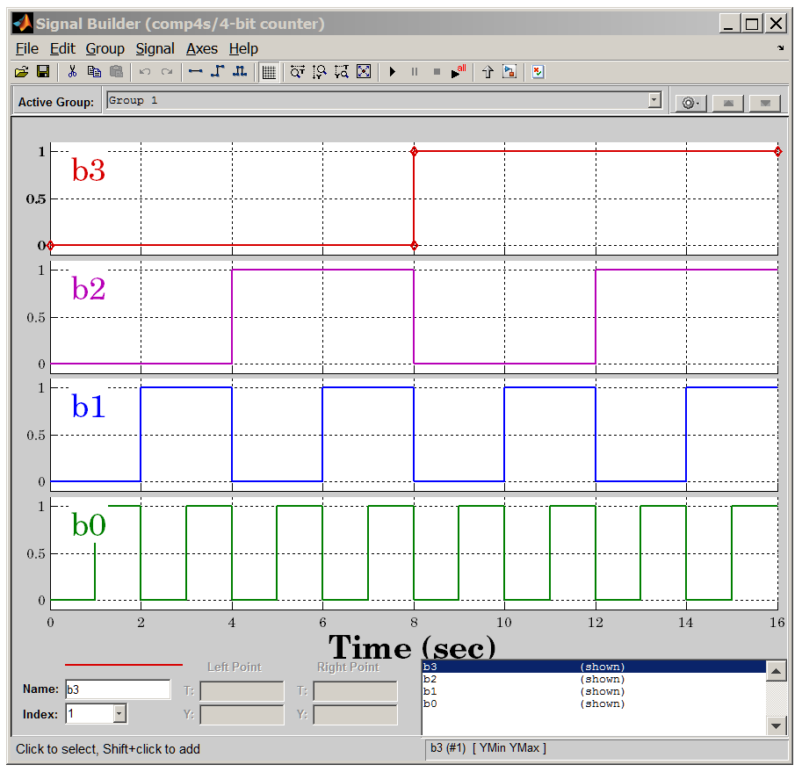
binary-counter

Slide 24
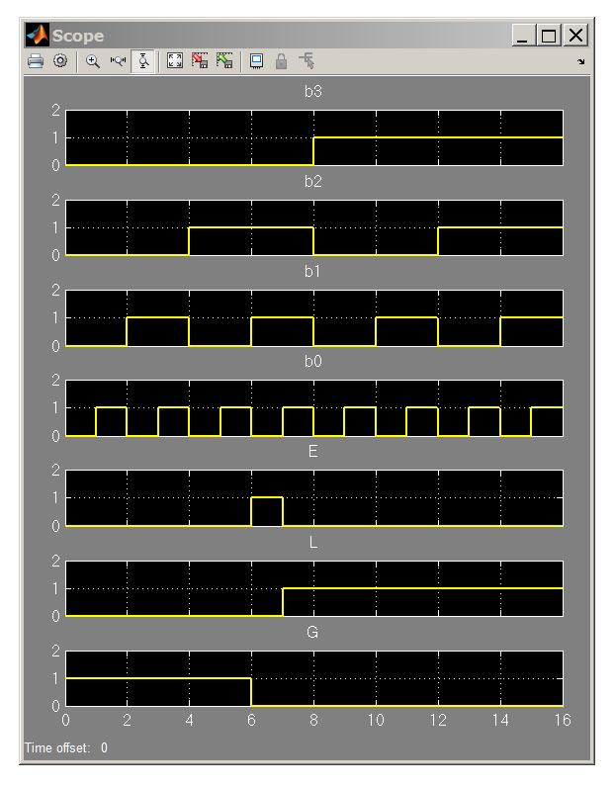
E = 1, only when
b = a = 6 = (0 1 1 0)
L = 1, while
b > a = 6 = (0 1 1 0)
G = 1, while
b < a = 6 = (0 1 1 0)

Slide 25
unsigned
2’s complement signed
x bits
----------------
0 0 0 0 0
1 0 0 0 1
2 0 0 1 0
3 0 0 1 1
4 0 1 0 0
5 0 1 0 1
6 0 1 1 0
7 0 1 1 1
8 1 0 0 0
9 1 0 0 1
10 1 0 1 0
11 1 0 1 1
12 1 1 0 0
13 1 1 0 1
14 1 1 1 0
15 1 1 1 1
x mod(x,16) bits
------------------------
-8 8 1 0 0 0
-7 9 1 0 0 1
-6 10 1 0 1 0
-5 11 1 0 1 1
-4 12 1 1 0 0
-3 13 1 1 0 1
-2 14 1 1 1 0
-1 15 1 1 1 1
0 0 0 0 0 0
1 1 0 0 0 1
2 2 0 0 1 0
3 3 0 0 1 1
4 4 0 1 0 0
5 5 0 1 0 1
6 6 0 1 1 0
7 7 0 1 1 1

Slide 26
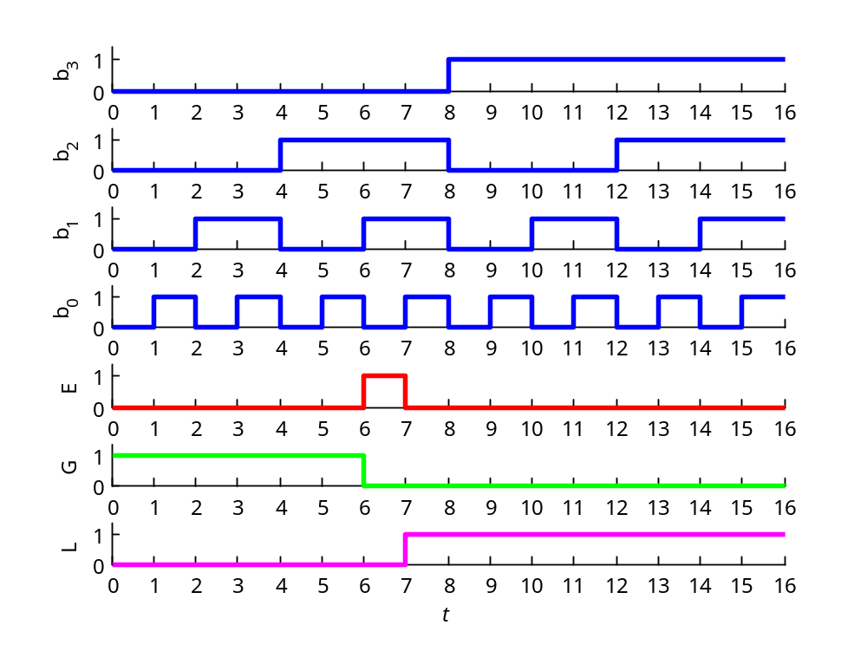
unsigned, a = 6 = (0110)
E = 1, only when
b = a = 6 = (0 1 1 0)
L = 1, while
b > a = 6 = (0 1 1 0)
G = 1, while
b < a = 6 = (0 1 1 0)

Slide 27
A = 6; a = a2d(A,4); % a = [0 1 1 0]
[b3,b2,b1,b0] = a2d(0:15, 4);
[E,G,L] = comp4(a,[b3,b2,b1,b0],1); % note, u = 1
E = [E; E(end)]; % extend duration of last bit
G = [G; G(end)];
L = [L; L(end)];
b3 = [b3; b3(end)];
b2 = [b2; b2(end)];
b1 = [b1; b1(end)];
b0 = [b0; b0(end)];
t = 0:16; % last bit lasts from t=15 to t=16
figure;
subplot(7,1,1); stairs(t,b3,'b-'); ylabel('b_3');
subplot(7,1,2); stairs(t,b2,'b-'); ylabel('b_2');
subplot(7,1,3); stairs(t,b1,'b-'); ylabel('b_1');
subplot(7,1,4); stairs(t,b0,'b-'); ylabel('b_0');
subplot(7,1,5); stairs(t,E, 'r-'); ylabel('E');
subplot(7,1,6); stairs(t,G, 'g-'); ylabel('G');
subplot(7,1,7); stairs(t,L, 'm-'); ylabel('L');
xlabel('\itt');

Slide 28
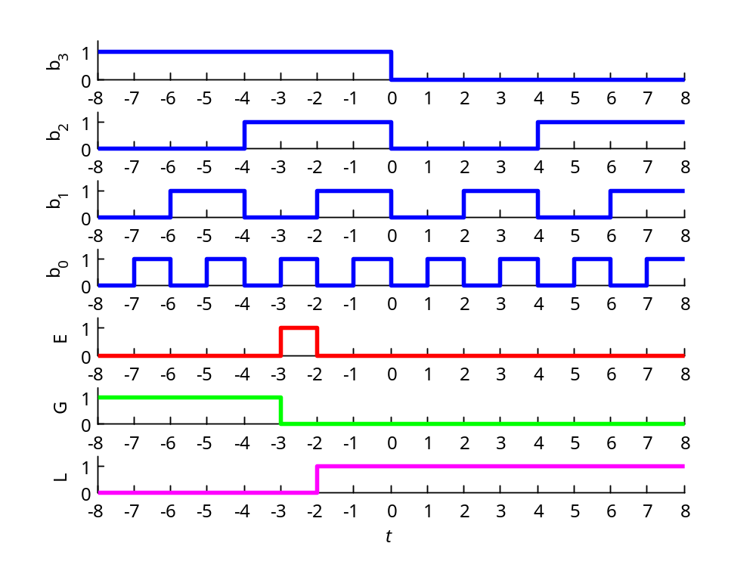
2’s complement, a = −3 = (1101)
E = 1, only when
b = a = −3 = (1 1 0 1)
L = 1, while
b > a = −3 = (1 1 0 1)
G = 1, while
b < a = −3 = (1 1 0 1)

Slide 29
A = -3; a = a2d(A,4); % a = [1 1 0 1]
[b3,b2,b1,b0] = a2d(-8:7, 4);
[E,G,L] = comp4(a,[b3,b2,b1,b0],0); % note, u = 0
E = [E; E(end)]; % extend duration of last bit
G = [G; G(end)];
L = [L; L(end)];
b3 = [b3; b3(end)];
b2 = [b2; b2(end)];
b1 = [b1; b1(end)];
b0 = [b0; b0(end)];
t = -8:8; % last bit lasts from t=7 to t=8
figure;
subplot(7,1,1); stairs(t,b3,'b-'); ylabel('b_3');
subplot(7,1,2); stairs(t,b2,'b-'); ylabel('b_2');
subplot(7,1,3); stairs(t,b1,'b-'); ylabel('b_1');
subplot(7,1,4); stairs(t,b0,'b-'); ylabel('b_0');
subplot(7,1,5); stairs(t,E, 'r-'); ylabel('E');
subplot(7,1,6); stairs(t,G, 'g-'); ylabel('G');
subplot(7,1,7); stairs(t,L, 'm-'); ylabel('L');
xlabel('\itt');

Slide 30
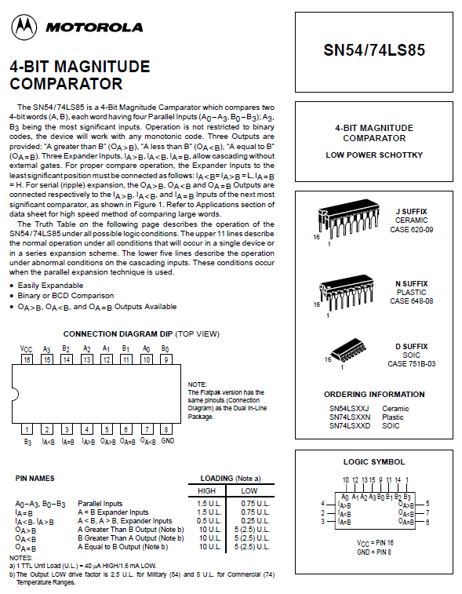

Slide 31
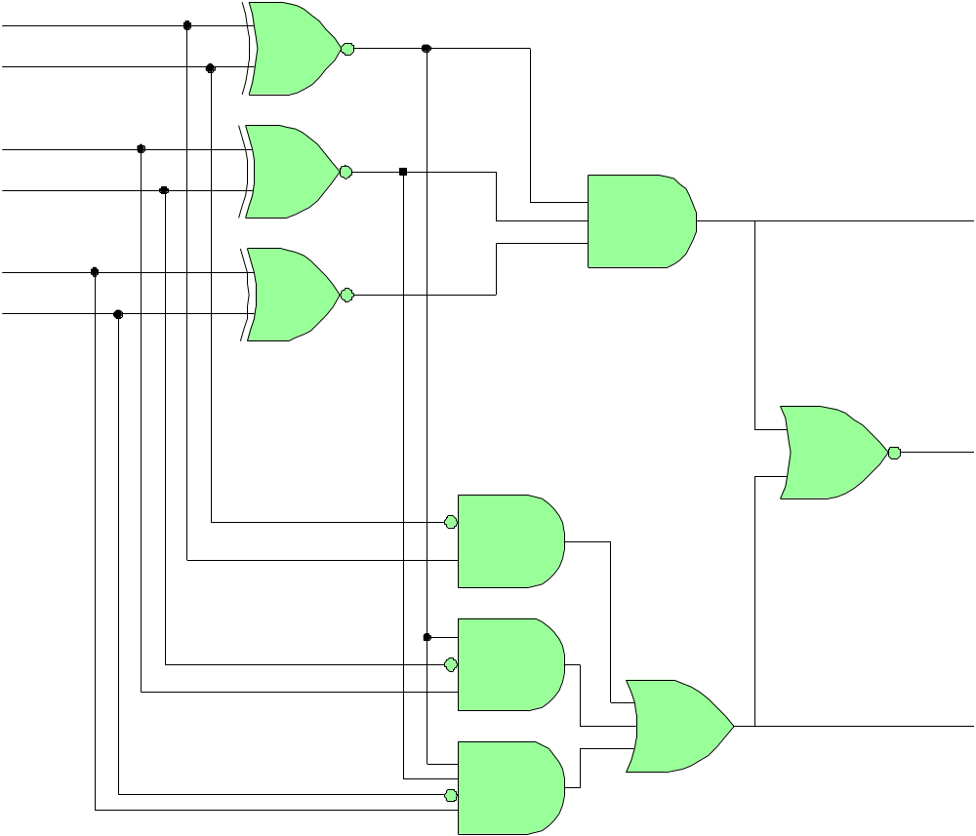
3-bit comparator
for unsigned integers
a₂
b₂
e₂
e₁
e₀
a₁
b₁
E_{a=b}
a₀
b₀
L_{a<b}
G_{a>b}

Slide 32

3-bit comparator
for 2’s complement
signed integers
a = (a₂ a₁ a₀)
b = (b₂ b₁ b₀)
selector
u
e₂
c
E_{a=b}
a₂
a₁
a₀
L
3-bit unsigned
comparator
L_{a<b}
b₂
c
b₁
b₀
c
G
G_{a>b}

Slide 33
Additional Examples - Problem 1
Design a combinational circuit that detects whether a 3-bit number,
a = [a₂, a₁, a₀], is less than 5, that is, a < 5, or, a ≤ 4.
Solution: Start with a truth-table and a K-map
a a2 a1 a0 F
----------------------
0 0 0 0 1
1 0 0 1 1
2 0 1 0 1
3 0 1 1 1
4 1 0 0 1
5 1 0 1 0
6 1 1 0 0
7 1 1 1 0
wrapped edges
a₂ a₁
a₀
00
01
11
10
0
1
1
1
1
1
1
F = a₂ʹ + a₁ʹ a₀ʹ

Slide 34
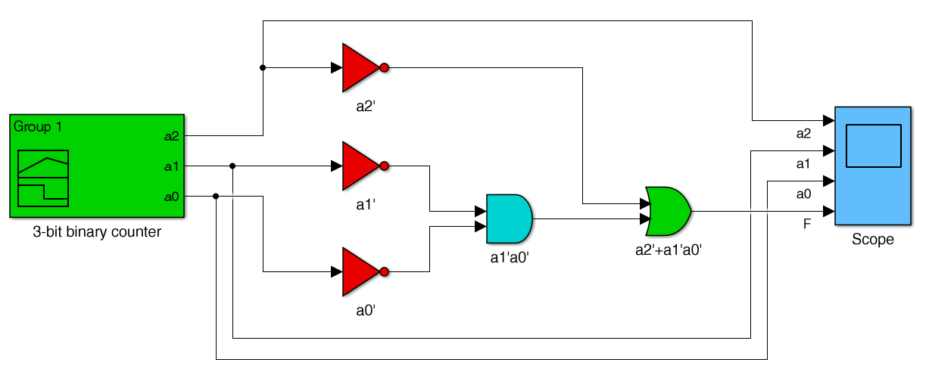
Implement with Simulink
F = a₂ʹ + a₁ʹ a₀ʹ

Slide 35
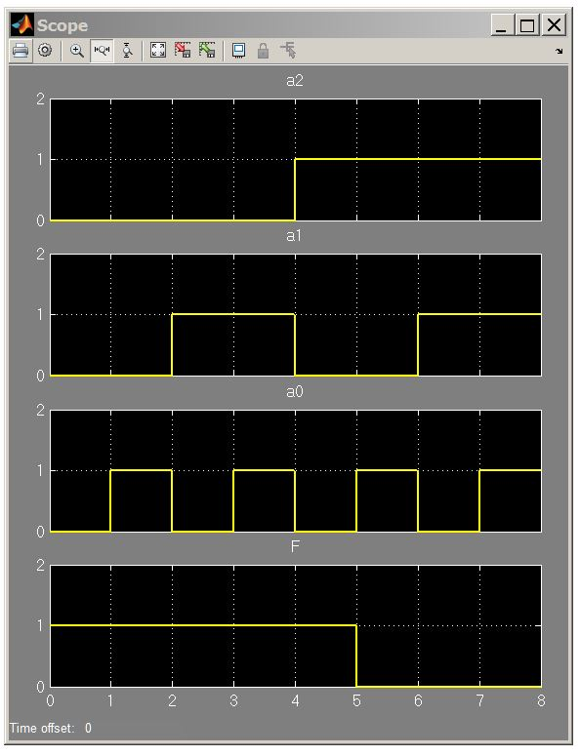
F = a₂ʹ + a₁ʹ a₀ʹ
t=4 extends to t=5

Slide 36
Additional Examples - Problem 2
Design a combinational circuit that detects whether a 4-bit number,
a = [a₃, a₂, a₁, a₀], is less than 5, that is, a < 5, or, a ≤ 4.
a a3 a2 a1 a0 F
------------------------
0 0 0 0 0 1
1 0 0 0 1 1
2 0 0 1 0 1
3 0 0 1 1 1
4 0 1 0 0 1
5 0 1 0 1 0
6 0 1 1 0 0
7 0 1 1 1 0
8 1 0 0 0 0
9 1 0 0 1 0
10 1 0 1 0 0
11 1 0 1 1 0
12 1 1 0 0 0
13 1 1 0 1 0
14 1 1 1 0 0
15 1 1 1 1 0
Solution
a₃ a₂
a₁ a₀
00
01
11
10
00
1
1
01
1
11
1
10
1
F = a₃ʹ a₂ʹ + a₃ʹ a₁ʹ a₀ʹ

Slide 37
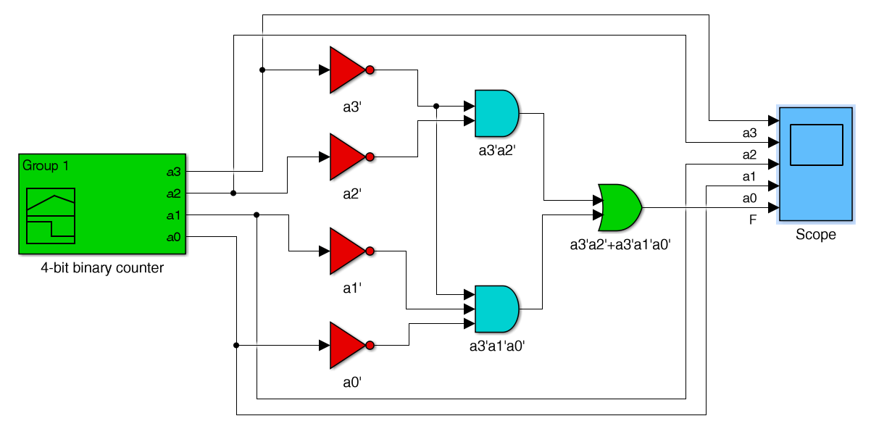
Implement with Simulink
F = a₃ʹ a₂ʹ + a₃ʹ a₁ʹ a₀ʹ

Slide 38
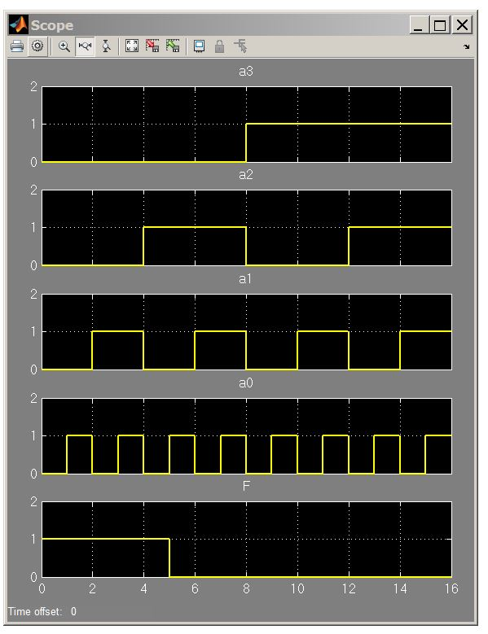
F = a₃ʹ a₂ʹ + a₃ʹ a₁ʹ a₀ʹ

Slide 39
Additional Examples - Problem 3
Design a combinational circuit that detects whether a 4-bit number,
a = [a₃, a₂, a₁, a₀], is in the range, 5 < a < 12, or, 6 ≤ a ≤ 11.
a a3 a2 a1 a0 F
-----------------------
0 0 0 0 0 0
1 0 0 0 1 0
2 0 0 1 0 0
3 0 0 1 1 0
4 0 1 0 0 0
5 0 1 0 1 0
6 0 1 1 0 1
7 0 1 1 1 1
8 1 0 0 0 1
9 1 0 0 1 1
10 1 0 1 0 1
11 1 0 1 1 1
12 1 1 0 0 0
13 1 1 0 1 0
14 1 1 1 0 0
15 1 1 1 1 0
Solution
a₃ a₂
a₁ a₀
00
01
11
10
00
1
01
1
11
1
1
10
1
1
F = a₃ a₂ʹ + a₃ʹ a₂ a₁

Slide 40
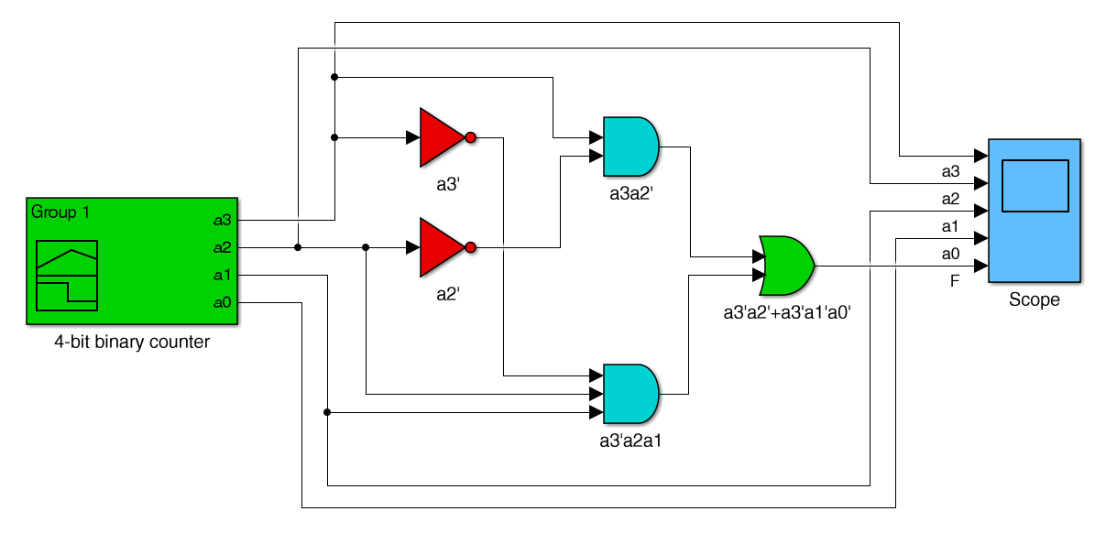
Implement with Simulink
F = a₃ a₂ʹ + a₃ʹ a₂ a₁

Slide 41
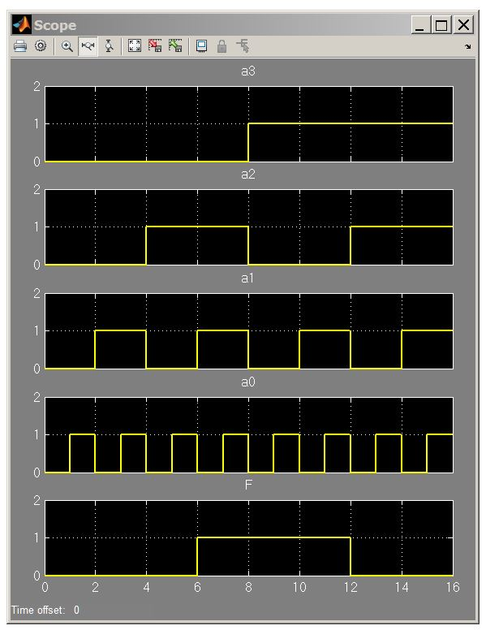
F = a₃ a₂ʹ + a₃ʹ a₂ a₁

Slide 42
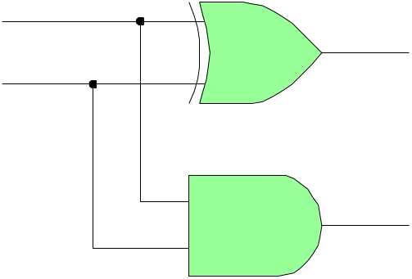
Addition and Subtraction − Half-Adders
Wakerly, Sect. 8.1
half adder
sum
a 0 1 0 1
+ b + 0 + 0 + 1 + 1
c s 0 0 0 1 0 1 1 0
decimals
carry 1 1
1 6 3
+ 2 9 7
4 5 0
a
s
HA
b
c
carry
truth table
s = a ∙ bʹ + aʹ ∙ b = a ⊕ b
c = a ∙ b
sum carry
a b s c
0 0 0 0
0 1 1 0
1 0 1 0
1 1 0 1
XOR
a
s
b
c

Slide 43
Addition and Subtraction − Full-Adders
full adder
truth table
c_{in}
half adder
s
c_{in} a b s c_{out}
0 0 0 0 0
0 0 1 1 0
0 1 0 1 0
0 1 1 0 1
1 0 0 1 0
1 0 1 0 1
1 1 0 0 1
1 1 1 1 1
a
FA
c_{out}
sum carry
a b s c
0 0 0 0
0 1 1 0
1 0 1 0
1 1 0 1
b
half-adder
case
a
b
c_{out}
FA
c_{in}
s
s = a ⊕ b ⊕ c_{in}
equivalent symbol, suitable for cascading full adders for multibit addition
c_{out} = a ∙ b + (a + b) ∙ c_{in}

Slide 44
full-adder
ab
truth table
c_{in}
00
01
11
10
c_{in} a b s c_{out}
0 0 0 0 0
0 0 1 1 0
0 1 0 1 0
0 1 1 0 1
1 0 0 1 0
1 0 1 0 1
1 1 0 0 1
1 1 1 1 1
0
1
1
K-map
for s
1
1
1
s = a ⊕ b ⊕ c_{in}
ab
c_{in}
00
01
11
10
0
1
K-map
for c_{out}
1
1
1
1
XOR properties
0 ⊕ X = X
1 ⊕ X = Xʹ
c_{out} = a ∙ b + (a + b) ∙ c_{in}
a ∙ b + a + b =
a(b+1) + b = a + b

Slide 45
full-adder
ab
c_{in}
00
01
11
10
0
1
1
K-map
for s
truth table
1
1
1
c_{in} a b s c_{out}
0 0 0 0 0
0 0 1 1 0
0 1 0 1 0
0 1 1 0 1
1 0 0 1 0
1 0 1 0 1
1 1 0 0 1
1 1 1 1 1
s = a ⊕ b ⊕ c_{in}
s = aʹ bʹ c_{in} + a b c_{in} + aʹ b cʹ_{in} + a bʹ cʹ_{in}
= (aʹ bʹ + a b) c_{in} + (aʹ b + a bʹ ) cʹ_{in}
= (a ⊕ b)ʹ c_{in} + (a ⊕ b) cʹ_{in}
= (a ⊕ b) ⊕ c_{in}

Slide 46
full-adder
a ∙ b
ab
c_{in}
00
01
11
10
truth table
0
1
c_{in} a b s c_{out}
0 0 0 0 0
0 0 1 1 0
0 1 0 1 0
0 1 1 0 1
1 0 0 1 0
1 0 1 0 1
1 1 0 0 1
1 1 1 1 1
K-map
for c_{out}
1
1
1
1
b ∙ c_{in}
a ∙ c_{in}
c_{out} = a ∙ b + (a + b) ∙ c_{in}
note also (looking at the K-map 0s,
c_{out}ʹ = aʹ ∙ bʹ + (aʹ + bʹ) ∙ c_{in}ʹ

Slide 47
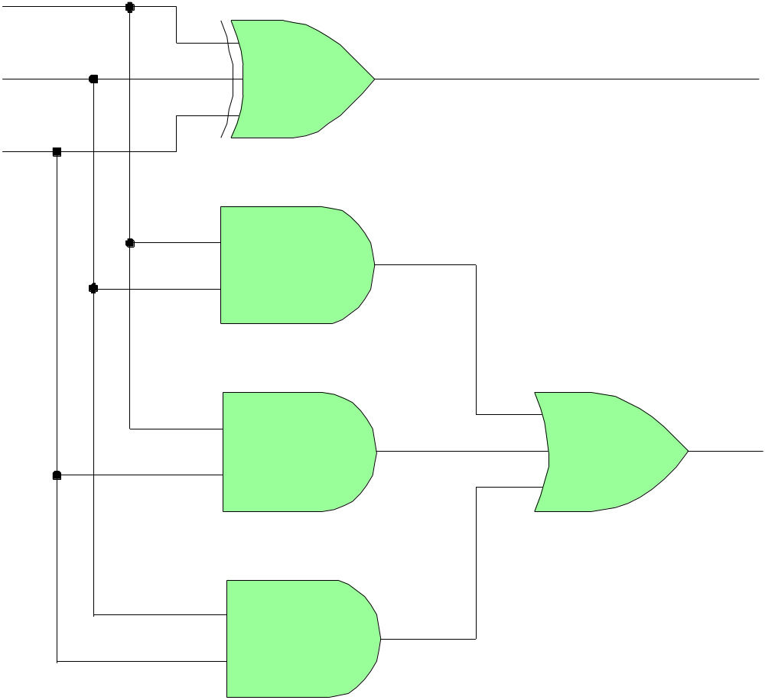
full-adder
c_{in}
a
s
b
s = a ⊕ b ⊕ c_{in}
c_{out} = a ∙ b + (a + b) ∙ c_{in}
c_{out}

Slide 48
full-adder implementation by cascading two half-adders
s = a ⊕ b ⊕ c_{in} = (a ⊕ b) ⊕ c_{in}
c_{out} = a ∙ b + a ∙ c_{in} + b ∙ c_{in} =
= a ∙ b + a ∙ (b + bʹ) ∙ c_{in} + b ∙ (a + aʹ ) ∙ c_{in}
= a ∙ b + a ∙ b ∙ c_{in} + a ∙ bʹ ∙ c_{in} + a ∙ b ∙ c_{in} + aʹ ∙ b ∙ c_{in}
= a ∙ b ∙ (1 + c_{in} + c_{in}) + (a ∙ bʹ + aʹ ∙ b) ∙ c_{in}
= a ∙ b + (a ⊕ b) ∙ c_{in}
half-adder outputs

Slide 49
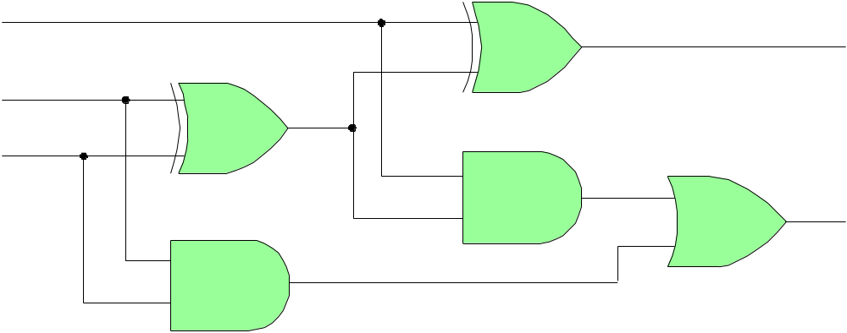
full-adder
a
s
b
c
half-adders
c_{in}
s
a
a ⊕ b
b
c_{out}
s = (a ⊕ b) ⊕ c_{in}
c_{out} = a ∙ b + (a ⊕ b) ∙ c_{in}

Slide 50
half-adder as special case of full-adder
c_{in} = 0
s
a
s
a
FA
HA
c_{out}
b
c
b
c_{in} = 0
s = a ⊕ b ⊕ c_{in} = a ⊕ b
c_{out} = a ∙ b + a ∙ c_{in} + b ∙ c_{in} = a ∙ b
truth table
half-adder
c_{in} a b s c_{out}
0 0 0 0 0
0 0 1 1 0
0 1 0 1 0
0 1 1 0 1
1 0 0 1 0
1 0 1 0 1
1 1 0 0 1
1 1 1 1 1
note also,
if, c_{in} = 1, then,
s = a ⊕ b ⊕ c_{in} = (a ⊕ b)ʹ
c_{out} = a ∙ b + a + b = a + b
XOR properties
0 ⊕ X = X
1 ⊕ X = Xʹ
a ∙ b + a + b =
a(b+1) + b = a + b

Slide 51
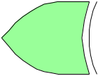
ripple-carry full-adder for 2’s complement integers
addition, a+b
a₃
b₃
a₂
b₂
a₁
b₁
a₀
b₀
c₄
c₃
c₂
c₁
c₀
FA
FA
FA
FA
v
c₃
s₃
s₂
s₁
s₀
c₄ c₃ c₂ c₁ c₀
a₃ a₂ a₁ a₀
b₃ b₂ b₁ b₀
s₃ s₂ s₁ s₀
v = c₄ ⊕ c₃
carries
addend
addend
sum
overflow bit, v = c_{N} ⊕ c_{N-1}, for N-bit case
for i = 0,1,2,3, do,
s_{i} = a_{i} ⊕ b_{i} ⊕ c_{i}
c_{i+1} = a_{i} ∙ b_{i} + (a_{i} + b_{i}) ∙ c_{i}

Slide 52

ripple-carry full-adder/subtractor for 2’s complement integers
addition, a+b
or
subtraction, a-b
a₃
b₃
a₂
b₂
a₁
b₁
a₀
b₀
sub
c₄
c₃
c₂
c₁
c₀
FA
FA
FA
FA
v
c₃
s₃
s₂
s₁
s₀
recall the properties,
X ⊕ 0 = X
X ⊕ 1 = Xʹ
a – b = a + (–b) = a + (b)_{2c} = a + (b)ʹ + 1
sub = 0, addition
sub = 1, subtraction

Slide 53
overflow rules for 2’s complement addition/subtraction:
1. Range: [-2^{N-1}, 2^{N-1}-1], for N-bit 2’s complement integers.
2. Overflow bit is computed by, v = c_{N} ⊕ c_{N-1}
3. If the numbers a, b are both positive or both negative, then, there
is no overflow (v=0) for the difference, a - b, and the output carry
c_{N} can be ignored (this also the case if one of the numbers a, b is
positive and the other negative and they are added.)
4. If the numbers a, b are both positive or both negative, then there
will be overflow in the sum, s = a + b, if s lies beyond the range,
[-2^{N-1}, 2^{N-1}-1], and in this case the overflow bit is v=1, and
the output carry c_{N} (whether it is 0 or 1) must be used to extend
the result to N+1 bits, i.e., c_{N} mut be prepended to become the MSB of
the resulting sum s.
see some examples in next few pages

Slide 54
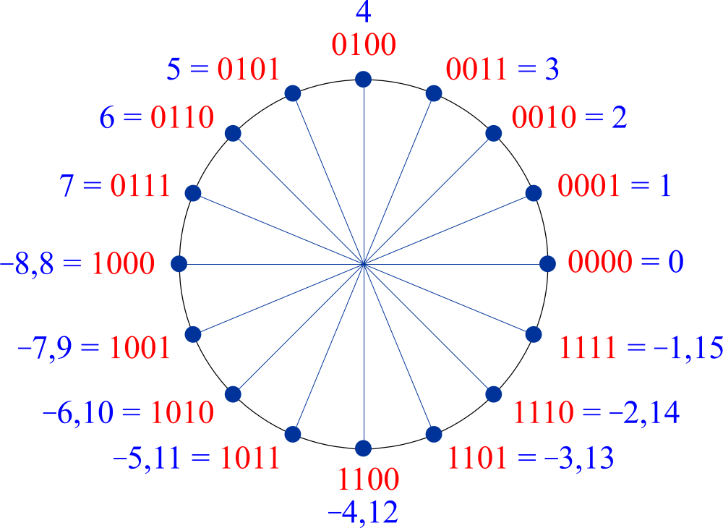
x mod(x,2⁴) bits
7 7 0 1 1 1
6 6 0 1 1 0
5 5 0 1 0 1
4 4 0 1 0 0
3 3 0 0 1 1
2 2 0 0 1 0
1 1 0 0 0 1
0 0 0 0 0 0
-1 15 1 1 1 1
-2 14 1 1 1 0
-3 13 1 1 0 1
-4 12 1 1 0 0
-5 11 1 0 1 1
-6 10 1 0 1 0
-7 9 1 0 0 1
-8 8 1 0 0 0
we recall that 2’s complement
negative 4-bit integers have the same bit pattern as their mod-16 positive counterparts
x = −b₃2³ + b₂2² + b₁2¹ + b₀

Slide 55
for N=4 case, range: [-2³, 2³-1] = [-8, 7]
if both numbers a,b are positive or both negative, then, there is no overflow for the difference, a-b, but there may be for their sum, a+b.
x bits
7 0 1 1 1
6 0 1 1 0
5 0 1 0 1
4 0 1 0 0
3 0 0 1 1
2 0 0 1 0
1 0 0 0 1
0 0 0 0 0
-1 1 1 1 1
-2 1 1 1 0
-3 1 1 0 1
-4 1 1 0 0
-5 1 0 1 1
-6 1 0 1 0
-7 1 0 0 1
-8 1 0 0 0
both a,b positive or zero,
0 ≤ a ≤ 7 0 ≤ a ≤ 7
⇒ ⇒ -7 ≤ a - b ≤ 7
0 ≤ b ≤ 7 -7 ≤ -b ≤ 0
but,
0 ≤ a + b ≤ 14, and sum requires possibly 5 bits
5-bit range:
[-2⁴, 2⁴-1] = [-16,15]
both a,b negative,
-8 ≤ a ≤ -1 -8 ≤ a ≤ -1
⇒ ⇒ -7 ≤ a - b ≤ 7
-8 ≤ b ≤ -1 1 ≤ -b ≤ 8
but,
-16 ≤ a + b ≤ -2 , and sum requires possibly 5 bits

Slide 56
for N=4 case, range: [-2³, 2³-1] = [-8, 7]
if one of the numbers a,b is positive and the other negative, then, there is no overflow for the sum, a+b, but there may be in their difference, a-b.
x bits
7 0 1 1 1
6 0 1 1 0
5 0 1 0 1
4 0 1 0 0
3 0 0 1 1
2 0 0 1 0
1 0 0 0 1
0 0 0 0 0
-1 1 1 1 1
-2 1 1 1 0
-3 1 1 0 1
-4 1 1 0 0
-5 1 0 1 1
-6 1 0 1 0
-7 1 0 0 1
-8 1 0 0 0
for example,
0≤ a ≤ 7 0 ≤ a ≤ 7
⇒ ⇒ 1 ≤ a - b ≤ 15, and can overflow
-8 ≤ b ≤ -1 1 ≤ -b ≤ 8
but,
-8 ≤ a + b ≤ 6 , and remains within the 4-bit range

Slide 57
c₄ c₃ c₂ c₁ c₀
carries: 0 0 0 0 0
5 = 0 1 0 1
2 = 0 0 1 0
7 = 0 1 1 1
v = 0 ⊕ 0 = 0
c₄ = 0, ignored
carries: 1 1 1 0 0
-5 = 1 0 1 1
-2 = 1 1 1 0
-7 = 1 0 0 1
v = 1 ⊕ 1 = 0
c₄ = 1, ignored
x bits
7 0 1 1 1
6 0 1 1 0
5 0 1 0 1
4 0 1 0 0
3 0 0 1 1
2 0 0 1 0
1 0 0 0 1
0 0 0 0 0
-1 1 1 1 1
-2 1 1 1 0
-3 1 1 0 1
-4 1 1 0 0
-5 1 0 1 1
-6 1 0 1 0
-7 1 0 0 1
-8 1 0 0 0
v = c₄ ⊕ c₃
4-bit
range
[-8,7]
carries: 1 1 0 0 0
5 = 0 1 0 1
-2 = 1 1 1 0
3 = 0 0 1 1
v = 1 ⊕ 1 = 0
c₄ = 1, ignored
carries: 0 0 1 0 0
-5 = 1 0 1 1
2 = 0 0 1 0
-3 = 1 1 0 1
v = 0 ⊕ 0 = 0
c₄ = 0, ignored
0 ⊕ X = X
1 ⊕ X = Xʹ

Slide 58
carries: 0 1 1 0 0
6 = 0 1 1 0
3 = 0 0 1 1
9 = 0 1 0 0 1
(5-bit)
v = 0 ⊕ 1 = 1
c₄ = 0, included
carries: 1 0 0 0 0
-6 = 1 0 1 0
-3 = 1 1 0 1
-9 = 1 0 1 1 1
(5-bit)
v = 1 ⊕ 0 = 1
c₄ = 1, included
9 = -7 + 16
7 = -9 + 16
23 = 32-9
x bits
7 0 1 1 1
6 0 1 1 0
5 0 1 0 1
4 0 1 0 0
3 0 0 1 1
2 0 0 1 0
1 0 0 0 1
0 0 0 0 0
-1 1 1 1 1
-2 1 1 1 0
-3 1 1 0 1
-4 1 1 0 0
-5 1 0 1 1
-6 1 0 1 0
-7 1 0 0 1
-8 1 0 0 0
v = c₄ ⊕ c₃
5-bit
range
[-16,15]
4-bit
range
[-8,7]
carries: 1 1 0 0 0
6 = 0 1 1 0
-3 = 1 1 0 1
3 = 0 0 1 1
v = 1 ⊕ 1 = 0
c₄ = 1, ignored
carries: 0 0 1 0 0
-6 = 1 0 1 0
3 = 0 0 1 1
-3 = 1 1 0 1
v = 0 ⊕ 0 = 0
c₄ = 0, ignored
0 ⊕ X = X
1 ⊕ X = Xʹ

Slide 59
carries: 0 1 1 0 0
6 = 0 1 1 0
3 = 0 0 1 1
9 = 0 1 0 0 1
v = 0 ⊕ 1 = 1
carries: 1 0 0 0 0
-6 = 1 0 1 0
-3 = 1 1 0 1
-9 = 1 0 1 1 1
v = 1 ⊕ 0 = 1
x bits
7 0 1 1 1
6 0 1 1 0
5 0 1 0 1
4 0 1 0 0
3 0 0 1 1
2 0 0 1 0
1 0 0 0 1
0 0 0 0 0
-1 1 1 1 1
-2 1 1 1 0
-3 1 1 0 1
-4 1 1 0 0
-5 1 0 1 1
-6 1 0 1 0
-7 1 0 0 1
-8 1 0 0 0
9 = -7 + 16
7 = -9 + 16
overflow occurs when, a₃,b₃, (or rather, a, b) have the same sign, but the sum, s₃, has the opposite sign, thus, we have alternatively,
v = a₃ b₃ s₃ʹ + a₃ʹ b₃ʹ s₃ = a₃ b₃ c₃ʹ + a₃ʹ b₃ʹ c₃ = c₄ ⊕ c₃
exercise exercise
or, more generally, v = a_{N-1} b_{N-1} s_{N-1}ʹ + a_{N-1}ʹ b_{N-1}ʹ s_{N-1}
= a_{N-1} b_{N-1} c_{N-1}ʹ + a_{N-1}ʹ b_{N-1}ʹ c_{N-1} = c_{N} ⊕ c_{N-1}

Slide 60
overflow occurs when, a₃,b₃, (or rather, a, b) have the same sign, but the sum, s₃, has the opposite sign, thus, we have alternatively,
v = a₃ b₃ s₃ʹ + a₃ʹ b₃ʹ s₃ = a₃ b₃ c₃ʹ + a₃ʹ b₃ʹ c₃ = c₄ ⊕ c₃
exercise exercise
to prove these, use the relationships:
s₃ = a₃ ⊕ b₃ ⊕ c₃
c₄ = a₃ ∙ b₃ + (a₃ + b₃) ∙ c₃

Slide 61
10 = 0 1 0 1 0
8 = 0 1 0 0 0
18 = 0 1 0 0 1 0
v,c5 = 1,0
some additional 5-bit examples from
f22-e2-practice.pdf
in each case, please work out all the carry bits
and the overflow bit
c₅ c₄ c₃ c₂ c₁ c₀
extended
-10 = 1 0 1 1 0
-8 = 1 1 0 0 0
-18 = 1 0 1 1 1 0
v,c5 = 1,1
v = c₅⊕ c₄
5-bit 6-bit
range range
[-16,15] [-32,31]
extended
5-bit
-10 = 1 0 1 1 0
8 = 0 1 0 0 0
-2 = 1 1 1 1 0
v,c5 = 0,0
x = −b₄2⁴ + b₃2³ + b₂2² + b₁2¹ + b₀
6-bit
x = −b₅2⁵ + b₄2⁴ + b₃2³ + b₂2² + b₁2¹ + b₀
not extended

Slide 62
x bits
15 0 1 1 1 1
14 0 1 1 1 0
13 0 1 1 0 1
12 0 1 1 0 0
11 0 1 0 1 1
10 0 1 0 1 0
9 0 1 0 0 1
8 0 1 0 0 0
7 0 0 1 1 1
6 0 0 1 1 0
5 0 0 1 0 1
4 0 0 1 0 0
3 0 0 0 1 1
2 0 0 0 1 0
1 0 0 0 0 1
0 0 0 0 0 0
-1 1 1 1 1 1
-2 1 1 1 1 0
-3 1 1 1 0 1
-4 1 1 1 0 0
-5 1 1 0 1 1
-6 1 1 0 1 0
-7 1 1 0 0 1
-8 1 1 0 0 0
-9 1 0 1 1 1
-10 1 0 1 1 0
-11 1 0 1 0 1
-12 1 0 1 0 0
-13 1 0 0 1 1
-14 1 0 0 1 0
-15 1 0 0 0 1
-16 1 0 0 0 0
more 5-bit practice examples
carries: 0 1 1 1 1 0
11 = 0 1 0 1 1
15 = 0 1 1 1 1
26 = 0 1 1 0 1 0
v = 1
5-bit
range
[-16,15]
6-bit
range
[-32,31]
v = c₅⊕ c₄
extended to 6 bits
carries: 1 0 0 0 1 0
-11 = 1 0 1 0 1
-15 = 1 0 0 0 1
-26 = 1 0 0 1 1 0
v = 1
carries: 1 1 1 1 1 0
-11 = 1 0 1 0 1
15 = 0 1 1 1 1
4 = 0 0 1 0 0
v = 0
extended to 6 bits
not extended
x = −b₅2⁵+b₄2⁴+b₃2³+b₂2²+b₁2¹+b₀

Slide 63
x 5-bit
15 0 1 1 1 1
14 0 1 1 1 0
13 0 1 1 0 1
12 0 1 1 0 0
11 0 1 0 1 1
10 0 1 0 1 0
9 0 1 0 0 1
8 0 1 0 0 0
7 0 0 1 1 1
6 0 0 1 1 0
5 0 0 1 0 1
4 0 0 1 0 0
3 0 0 0 1 1
2 0 0 0 1 0
1 0 0 0 0 1
0 0 0 0 0 0
-1 1 1 1 1 1
-2 1 1 1 1 0
-3 1 1 1 0 1
-4 1 1 1 0 0
-5 1 1 0 1 1
-6 1 1 0 1 0
-7 1 1 0 0 1
-8 1 1 0 0 0
-9 1 0 1 1 1
-10 1 0 1 1 0
-11 1 0 1 0 1
-12 1 0 1 0 0
-13 1 0 0 1 1
-14 1 0 0 1 0
-15 1 0 0 0 1
-16 1 0 0 0 0
x 6- bit x 6-bit
31 0 1 1 1 1 1 -1 1 1 1 1 1 1
30 0 1 1 1 1 0 -2 1 1 1 1 1 0
29 0 1 1 1 0 1 -3 1 1 1 1 0 1
28 0 1 1 1 0 0 -4 1 1 1 1 0 0
27 0 1 1 0 1 1 -5 1 1 1 0 1 1
26 0 1 1 0 1 0 -6 1 1 1 0 1 0
25 0 1 1 0 0 1 -7 1 1 1 0 0 1
24 0 1 1 0 0 0 -8 1 1 1 0 0 0
23 0 1 0 1 1 1 -9 1 1 0 1 1 1
22 0 1 0 1 1 0 -10 1 1 0 1 1 0
21 0 1 0 1 0 1 -11 1 1 0 1 0 1
20 0 1 0 1 0 0 -12 1 1 0 1 0 0
19 0 1 0 0 1 1 -13 1 1 0 0 1 1
18 0 1 0 0 1 0 -14 1 1 0 0 1 0
17 0 1 0 0 0 1 -15 1 1 0 0 0 1
16 0 1 0 0 0 0 -16 1 1 0 0 0 0
15 0 0 1 1 1 1 -17 1 0 1 1 1 1
14 0 0 1 1 1 0 -18 1 0 1 1 1 0
13 0 0 1 1 0 1 -19 1 0 1 1 0 1
12 0 0 1 1 0 0 -20 1 0 1 1 0 0
11 0 0 1 0 1 1 -21 1 0 1 0 1 1
10 0 0 1 0 1 0 -22 1 0 1 0 1 0
9 0 0 1 0 0 1 -23 1 0 1 0 0 1
8 0 0 1 0 0 0 -24 1 0 1 0 0 0
7 0 0 0 1 1 1 -25 1 0 0 1 1 1
6 0 0 0 1 1 0 -26 1 0 0 1 1 0
5 0 0 0 1 0 1 -27 1 0 0 1 0 1
4 0 0 0 1 0 0 -28 1 0 0 1 0 0
3 0 0 0 0 1 1 -29 1 0 0 0 1 1
2 0 0 0 0 1 0 -30 1 0 0 0 1 0
1 0 0 0 0 0 1 -31 1 0 0 0 0 1
0 0 0 0 0 0 0 -32 1 0 0 0 0 0
5-bit and 6-bit
two’s complement
refererence tables
ranges:
5-bit: [−16, 15]
6-bit: [−32, 31]

Slide 64
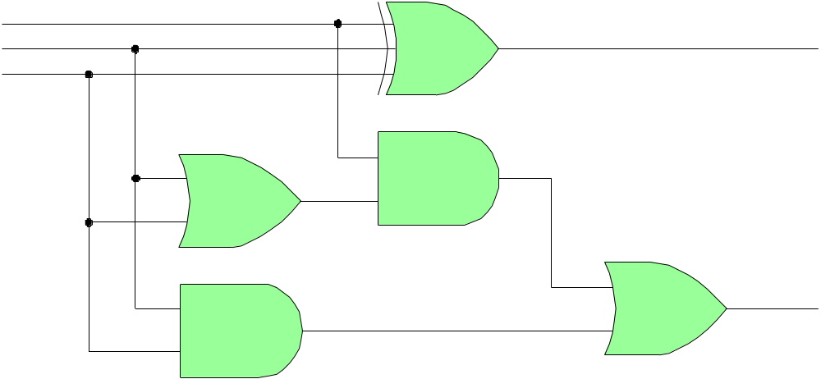
carry-lookahead adder
s = a ⊕ b ⊕ c_{in}
g = a ∙ b = carry-generate
p = a + b = carry-propagate
c_{out} = a ∙ b + (a + b) ∙ c_{in}
c_{out} = g + p ∙ c_{in}
c_{in}
a
s
b
p
g
c_{out}

Slide 65
carry-lookahead adder
a₃
b₃
a₂
b₂
a₁
b₁
a₀
b₀
c₄
c₃
c₂
c₁
c₀
FA
FA
FA
FA
v
c₃
s₃
s₂
s₁
s₀
c₁ = g₀ + p₀ ∙ c₀ ( g₀ = a₀ ∙ b₀ , p₀ = a₀ + b₀ )
c₂ = g₁ + p₁ ∙ c₁ ( g₁ = a₁ ∙ b₁ , p₁ = a₁ + b₁ )
= g₁ + p₁ ∙ g₀ + p₁ ∙ p₀ ∙ c₀
c₃ = g₂ + p₂ ∙ c₂
= g₂ + p₂ ∙ g₁ + p₂ ∙ p₁ ∙ g₀ + p₂ ∙ p₁ ∙ p₀ ∙ c₀
c₄ = g₃ + p₃ ∙ c₃
= g₃ + p₃ ∙ g₂ + p₃ ∙ p₂ ∙ g₁ + p₃ ∙ p₂ ∙ p₁ ∙ g₀ + p₃ ∙ p₂ ∙ p₁ ∙ p₀ ∙ c₀

Slide 66
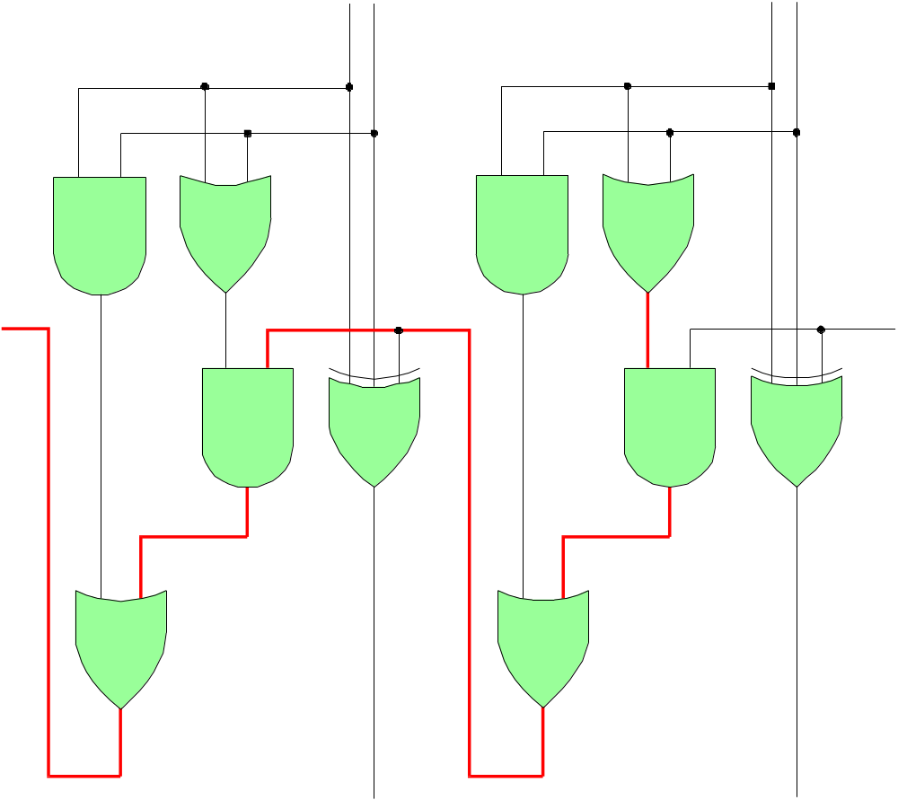
a₁
b₁
a₀
b₀
c₁
c₀
c₁ = g₀+ p₀c₀
c₂ = g₁+ p₁g₀+p₁p₀c₀
c₂
g₁
p₁
g₀
p₀
long
propagation
path
stage-2
s₁
stage-1
s₀

Slide 67
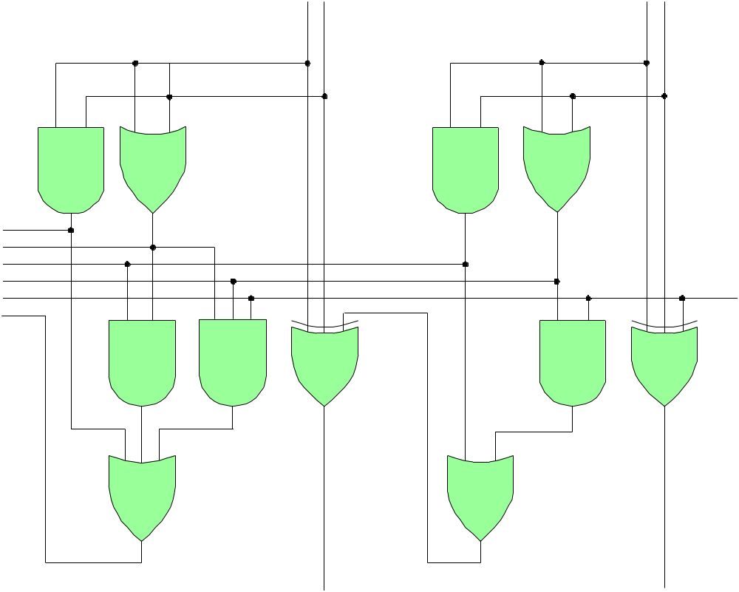
a₁
b₁
a₀
b₀
carry-lookahead adder
g₁
p₁
g₀
p₀
c₁ = g₀+ p₀c₀
c₂ = g₁+ p₁g₀+p₁p₀c₀
c₀
c₂
c₁
stage-2
s₁
stage-1
s₀

Slide 68
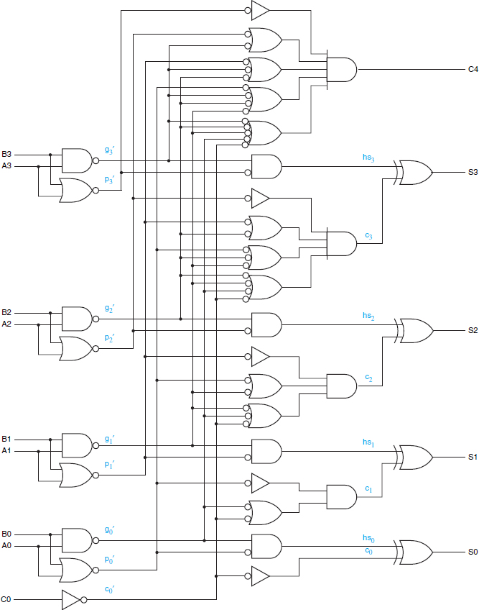
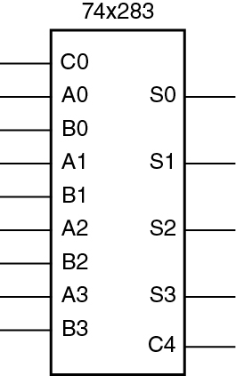
Fig. 8-6. Logic Diagram for the 74×283
4-Bit Binary Adder with Internal
Carry Lookahead
carry-lookahead adder

Slide 69
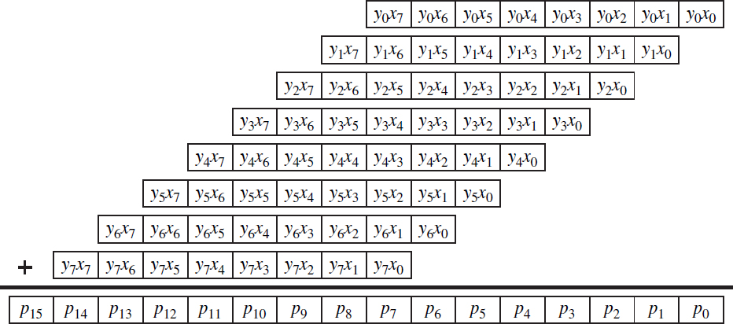
Fig. 8-22. Partial Products for an 8 × 8 Multiplier
x₇ x₆ x₅ x₄ x₃ x₂ x₁ x₀
y₇ y₆ y₅ y₄ y₃ y₂ y₁ y₀
partial products can be realized by AND gates
decimals
1 6 3
x 2 9 7
1 1 4 1
1 4 6 7
3 2 6
4 8 4 1 1

Slide 70
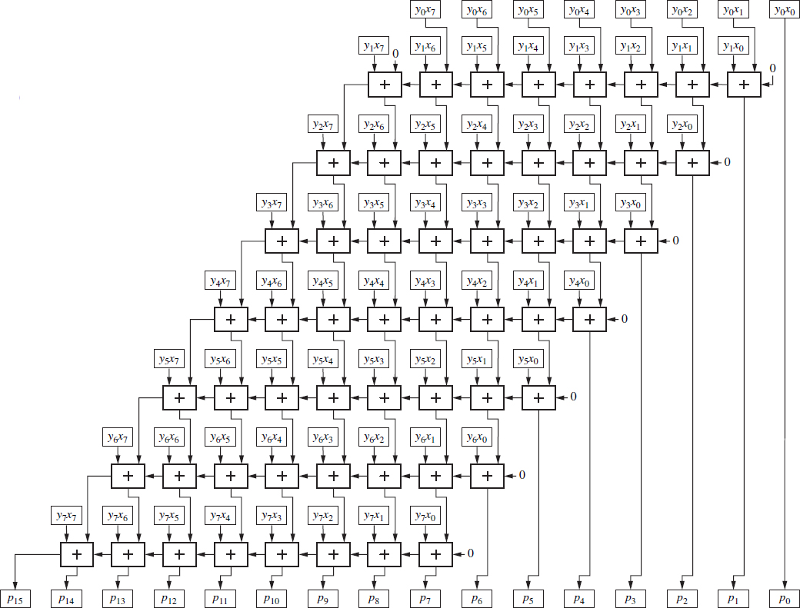
Fig. 8-23. Interconnections for
an 8 × 8 Combinational Multiplier
+ signs indicate
full-adders

